Slide 1
Smart Shrimp Farming
IN 1900 (ICT Project)
Final Presentation
Group No: 31

Slide 2





Group Members
204192X Sara
A.N. Z (Group Leader)
204130H Megasuriya M.M.A.M.J
204006J Appuhamy H.D.S.A.N
204155M perera J.K.A.T
204171H Rajapaksha S.S.D

Slide 3
Content
Problem in Brief
Aim and objectives
Input -output diagram
3D diagram
Animation
Full Circuit
Resources Required
Cost Estimation
Individual Contributions

Slide 4
Problem in brief
Although shrimp farming gives a huge amount of progress in the economy, the shrimp farmers face more challenges to achieve their expected goals.
▪ Manual monitoring and lack of maintaining proper record
▪ Necessity for more man power
▪ Hard to maintain the growth of shrimps
▪ Lack of knowledge in maintaining the quality of water

Slide 5
Aim & Objectives
Aim
Design and devolop the system to assist our local shrimp farmers in easing their work and saving their time.
Objectives
To help the farmer to control and monitor the shrimp ponds from a distance .
To feed the shrimps automatically with a proper record of time and mass.
To monitor the consumption of food easily.
Monitoring the cultivation using the pH, Temperature, Mass of food and Date and Time schedule of feeding shrimps.
To operate motors and lamps automatically with a phone.
To monitor the quality and control the level of water

Slide 6
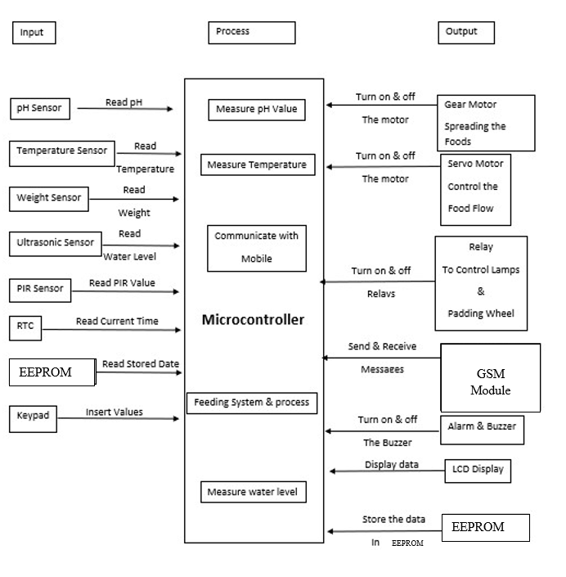
Input Output Diagram

Slide 7
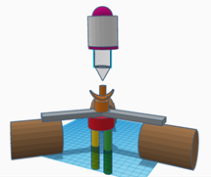
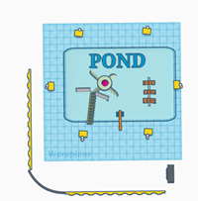
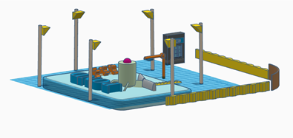
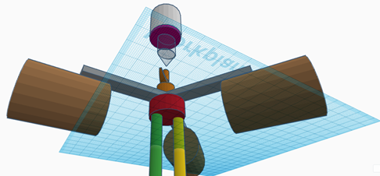
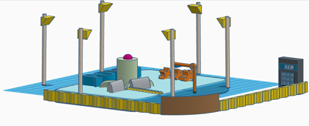
3D Diagram

Slide 8
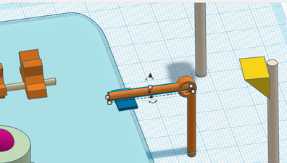
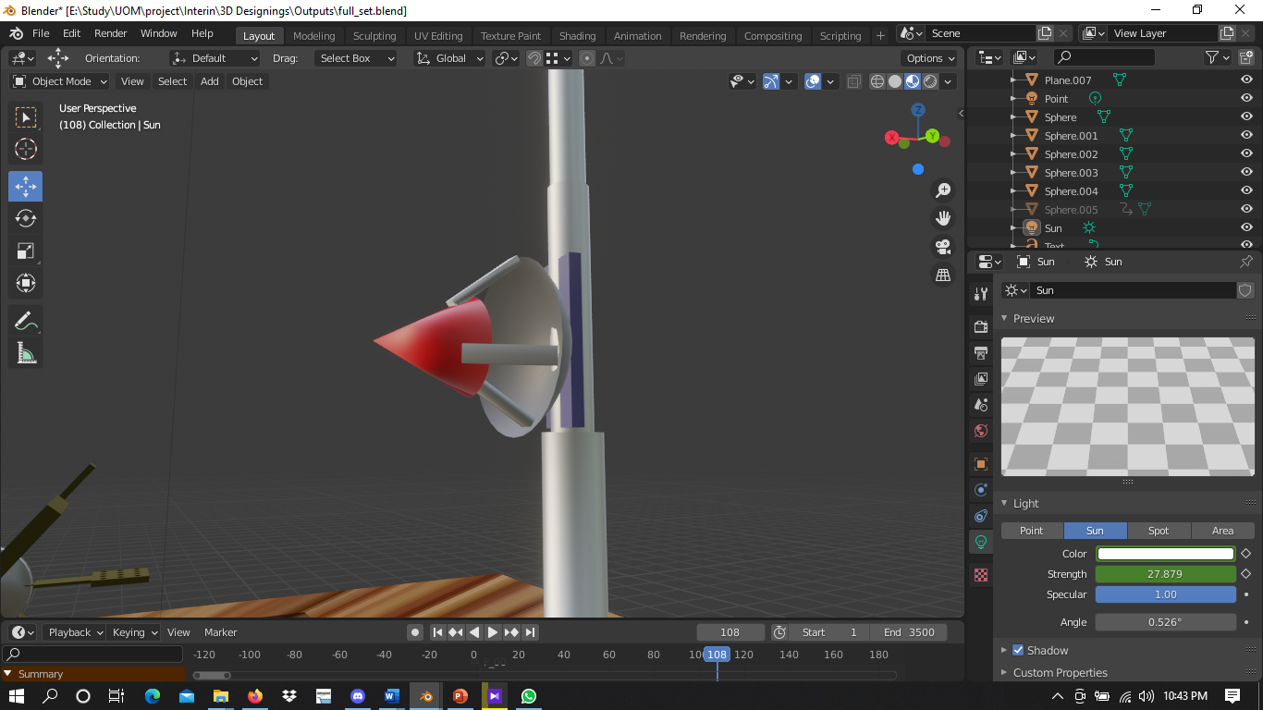
3D Diagram Cont.
PIR Sensor

Slide 9
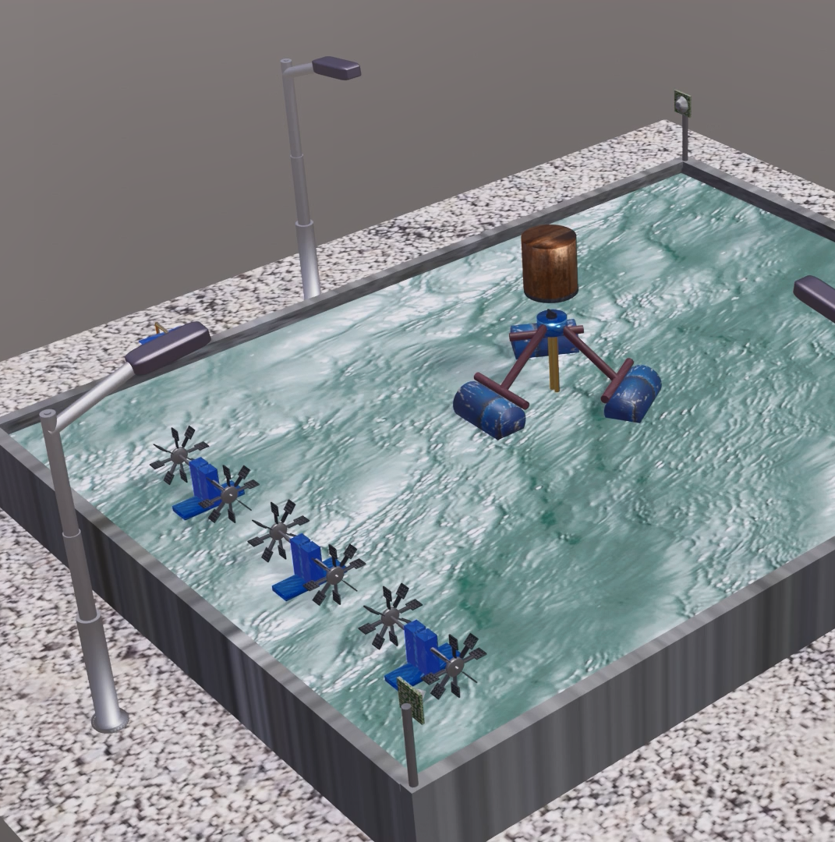
Animation
Src: Final Animation

Slide 10
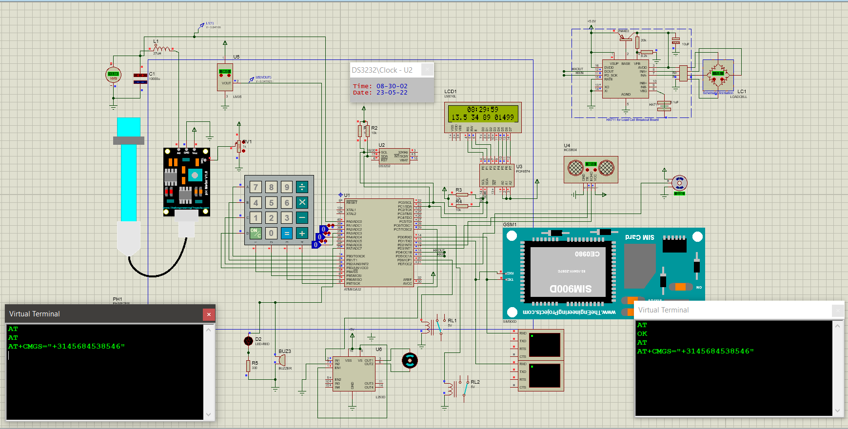
Full Circuit Diagram

Slide 11
Resources Required
Hardware:
1. Sensors
● pH sensor
● Temperature sensor
● Weight sensor
● Ultrasonic sensor
● PIR Sensor
2. Relay
3. Atmega32 Controller
4. Real Time Clock Module
5. EEPROM
6. Buzzer
7. Gear Motor
8. Servo Motor
9. Keypad
10. LCD Display
11. Power Supply
12. Gsm
Software:
● Atmel Studio
● Proteus
● Blender
● Kicad

Slide 12
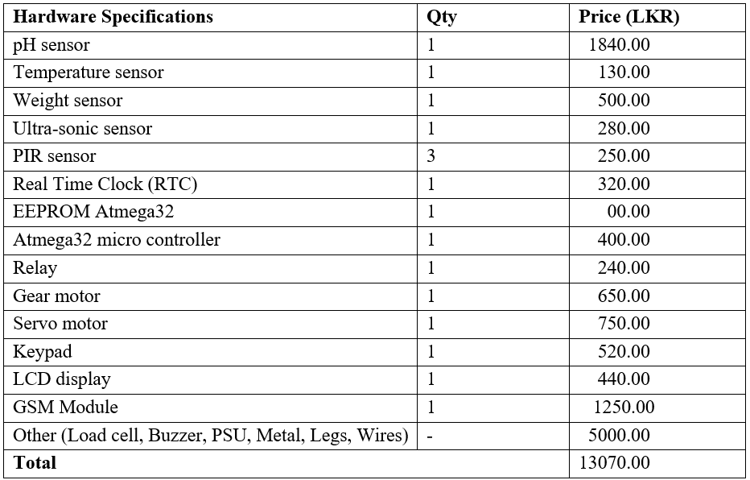
Cost Estimation

Slide 13
Individual
Contribution

Slide 14
Member 01: Sara A.N.Z- 204192X
Our hardware project is to construct a shrimp feeding system. I discovered what needed to be done by communicating with my project partners, attending hardware project meetings, and conducting research. First, we drafted the proposal by explaining our problem and the suggested solution. Throughout those days, I learned about the technologies that we want to use to develop the system.
● Learning about servo motor
● Learning to simulate using Proteus
● Learning to do 3D animation
I have learnt to develop interfacing servo motors, the structure of it and how it could be used in our project and to design and code a servo motor. I too learnt to use Proteus software to simulate the circuit. I too learnt to make 3D animations using Blender.

Slide 15
Responsibilities
Learning about ultrasonic sensor , servo motor, PIR sensor and how they work.
Learning to connect Ultrasonic sensor to atmega32 microcontroller and Refer the code part of it.
Learning to connect Servo motor to atmega32 microcontroller Refer the code part of it.
Learning to connect PIR sensor to atmega32 microcontroller Refer the code part of it.
Identifying devices needed, when connecting these components to atmega32 microcontroller.
Learning to do 3D animations.

Slide 16
Techniques
Ultra-sonic Sensor
The ultrasonic sensor is used here to detect the water level, when the water level goes down, and goes up, the alert messages are sent to the farmer’s phone.
Servo Motor
Servo motor is used to control the flow of food gradually, from the main tank to the Gear motor.
PIR Sensor
PIR sensor is used for a security purpose to protect the shrimps from the birds.

Slide 17
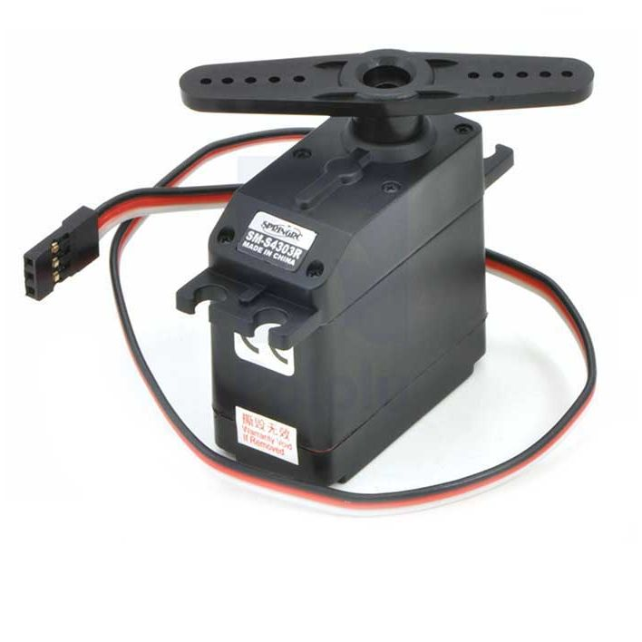
Servo Motor
Maximum Voltage = 6V
Maximum Current = 100mA
Pin = 03
VCC
Ground
Signal
Link for Data sheet : https://www.tme.eu/Document/004105658202ef89808bba102ca4bf3f/POLOLU-1248.pdf

Slide 18
Specifications
Motor Properties
Motor Type | Continuous Rotation Servo
Rated Torque | 3.3 kg·cm
Rated Speed | 56 RPM
Physical Properties
Gear Train Material | 1 Metal, 4 Plastic
Weight | 41 g
Electrical Properties
Rated Voltage | 5 V DC
Rated Current (on 1061 controller) | 110 mA
Rated Current (on 1066 controller) | 120 mA
Stall Current (on 1061 controller) | 800 mA
Stall Current (on 1066 controller) | 415 mA

Slide 19
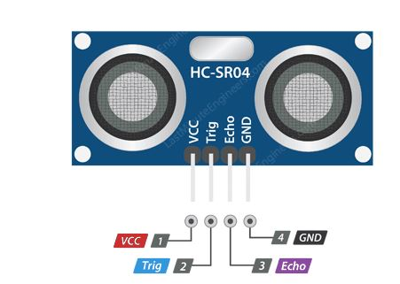
Ultra-Sonic Sensor
Range = 2cm – 400cm
Wire Connecting directs,
5V Supply
Trigger Pulse Input
Echo Pulse Output
0V Ground
Link for Data sheet:
https://cdn.sparkfun.com/datasheets/Sensors/Proximity/HCSR04.pdf

Slide 20
Specification
Ultrasonic Ranging Module HC - SR04
Working Voltage | DC 5 V
Working Current | 15mA
Working Frequency | 40Hz
Max Range | 4m
Min Range | 2cm
Measuring Angle | 15 degree
Trigger Input Signal | 10uS TTL pulse
Echo Output Signal | Input TTL lever signal and the range in proportion
Dimension | 45*20*15mm

Slide 21
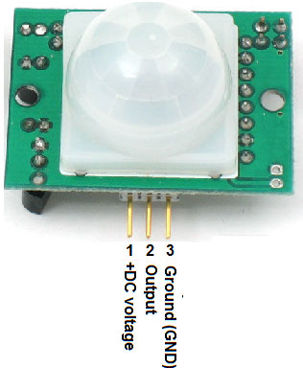
PIR Sensor
Automatic infrared detection - Infrared technology (LHI778 probe design)
High sensitivity | high reliability
Ultra-low-voltage
Widely used especially for battery-powered products
Link for Data sheet
https://datasheetspdf.com/pdf-file/775435/ETC/HC-SR501/1

Slide 22
Specification
Voltage | 4.8 V – 20 V
Current (idle) | <50 µA
Logic output | 3.3 V / 0 V
Delay time | 0.3 s – 200 s, custom up to 10 min
Lock time | 2.5 s (default)
Trigger | repeat : L = disable , H = enable
Sensing range | <120 °, within 7 m
Temperature | – 15 ~ +70 °C
Dimension | 32 x 24 mmscrew-screw 28 mm, M2 Lens diameter: 23 mm

Slide 23
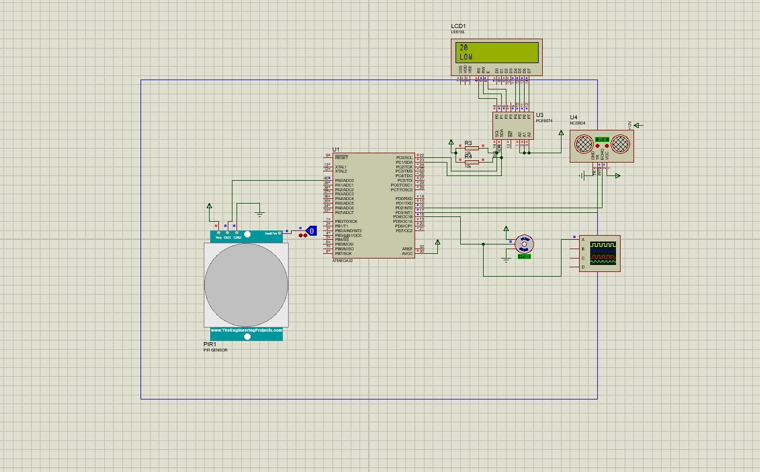
Circuit Diagram

Slide 24
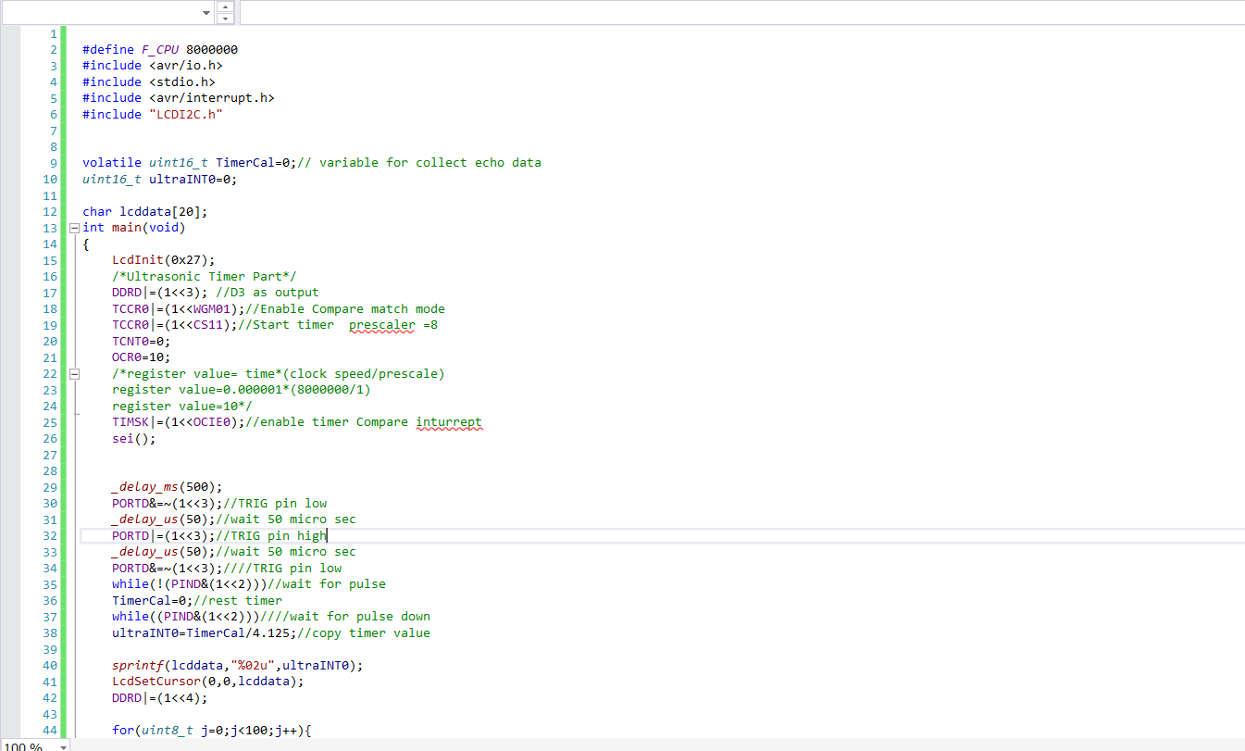
Code

Slide 25
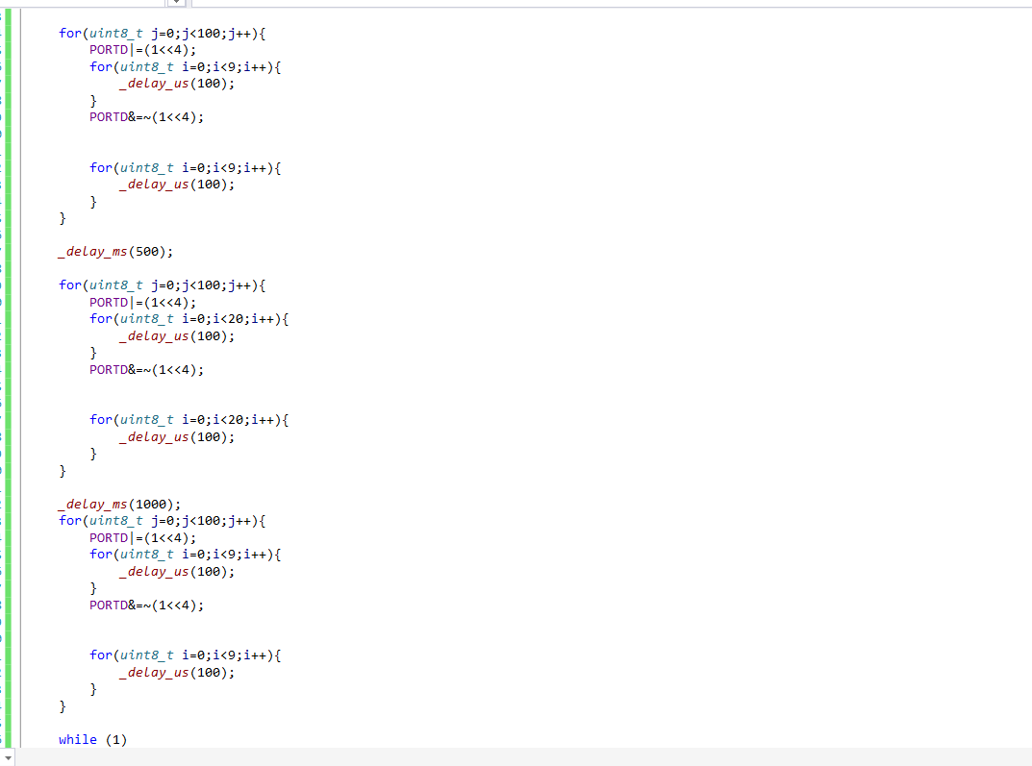
Code 2

Slide 26
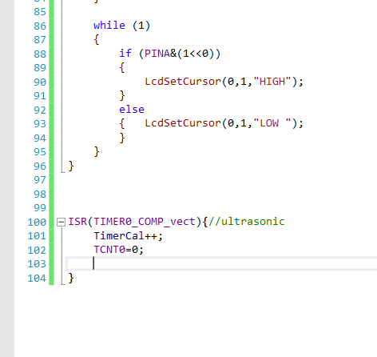
Code 3

Slide 27
Member 02: Megasuriya M.M.A.M.J- 204130H
Our hardware project will be to manufacture a shrimp feeding mechanism. I recognized what needed to be done by engaging with my project teammates, attending hardware project meetings, and conducting research. First, we drafted the proposal by explaining our problem and the suggested solution. Throughout those days, I learned about the technologies that we want to use to develop the system.
● Learning about relay,keypad and pH sensor
● Learning to simulate using Proteus
● Learning to do 3D animation
I have learnt about designing and coding a relay ,keypad and a pH sensor.learnt to use Proteus software to simulate the circuit. I too learnt to make 3D animations using Blender.
In this time I have completed my work on this project.

Slide 28
Resposibilities
Learning pH sensor ,relay, keypad and how it works
Identifying the correct pins and components models
Learning How to connect to pH sensor to atmega32 microcontroller Refer the code part of them
Learning How to connect to relay to atmega32 microcontroller Refer the code part of them
Learning How to connect to keypad to atmega32 microcontroller Refer the code part of them
Do the simulations of pH sensor, relay and keypad
Identifying devices needed to when connecting to those sensors to atmega32 microcontroller
Learning to do 3D animations

Slide 29
Techniques
PH sensor
PH sensor is used for masuring the ph value in the pond. ph value between 5 and 9 is best for the survival of the shrimp.When the pH is less than 5 or higher than 9, a message is sent over the
phone to inform the prawn that it is detrimental to its survival.
Relay
The relay is used here to light the lamps around the pond.
Keypad
Here the keypad is used to enter input values such as the feeding time of the prawns and to end that feeding time,input the amount of food,activates lamps turn on and off.

Slide 30
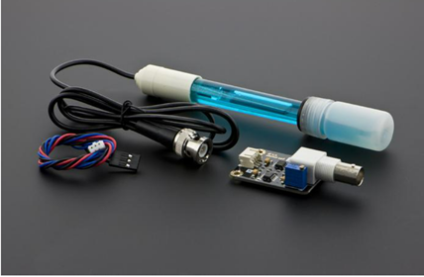
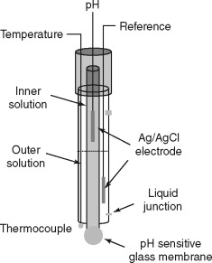
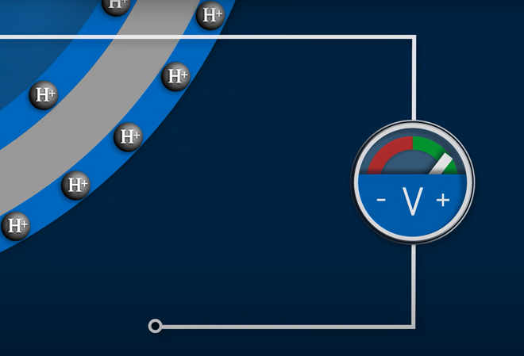
pH sensor
Link for data sheet -https://cdn.awsli.com.br/969/969921/arquivos/ph-sensor-ph-4502c.pdf

Slide 31
Specifications of pH sensor
Module-PH4502C PH Meter
Heating voltage: 5±0.2V (AC -• DC)
Working current: 5-10mA
The detection concentration range: PH0-14
The detection range of temperature: 0-60 centigrade The response time: ≤ 5S
Stability time: ≤ 60S
Power consumption: ≤ 0.5W
The working temperature: -10~50 centigrade (the nominal temperature 20 centigrade)
Working humidity: 95%RH (nominal humidity 65%RH)
Service life: 3 years
Size: 42mm x 32mm x 20mm

Slide 32
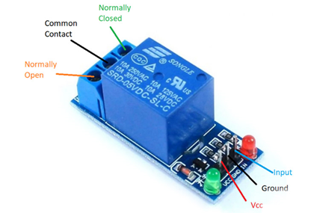
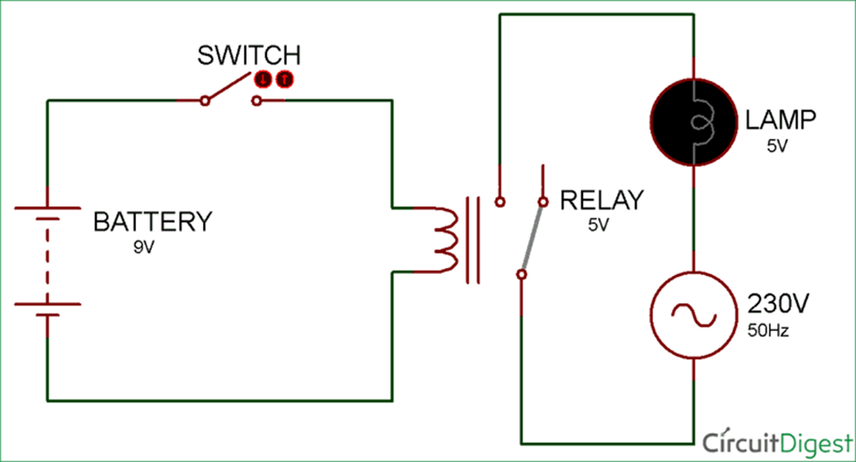
Relay circuit

Slide 33
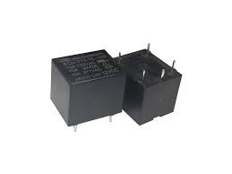
Specifications of relay
Trigger Voltage (Voltage across coil) : 5V DC
Trigger Current (Nominal current) : 70mA
Maximum current: 10A
Compact 5-pin configuration with plastic moulding
Operating time: 10msec Release time: 5msec
Maximum switching: 300 operating/minute (mechanically)
Link for data sheet-https://datasheet.octopart.com/T73S5D15-09-Tyco-Electronics-datasheet-70808.pdf

Slide 34
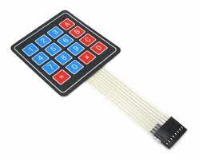
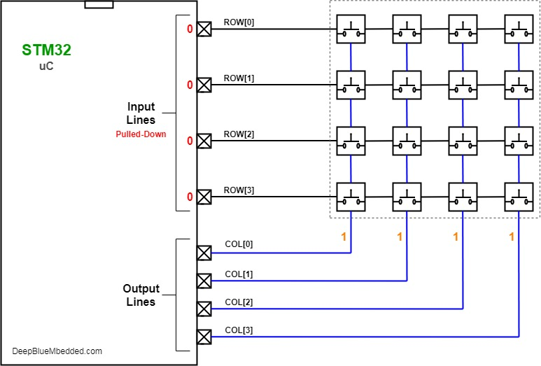
Keypad

Slide 35
Specifications of Keypad
Ultra-thin design & adhesive backing provides easy integration
Maximum Rating: 24 VDC, 30 mA
Interface: 8-pin access to 4×4 matrix
Dimensions: Keypad: 2.7 x 3.0 in (6.9 x 7.6 cm) Cable: 0.78 x 3.5 in (2.0 x 8.8 cm)
Operating temp range: 32 to 122 °F (0 to 50 °C)
Link to datasheet-http://www.electronicoscaldas.com/datasheet/Teclado-membrana-matricial-4x4.pdf

Slide 36
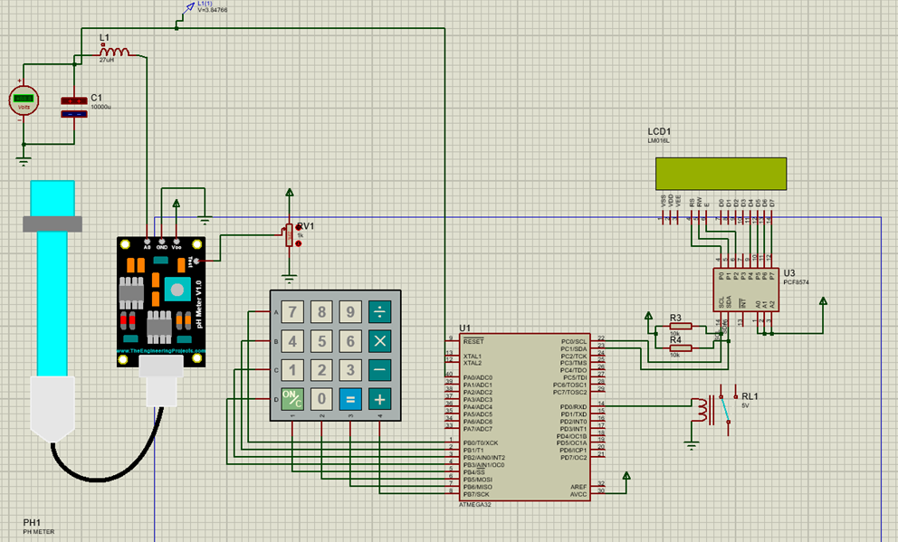
Circuit diagram

Slide 37
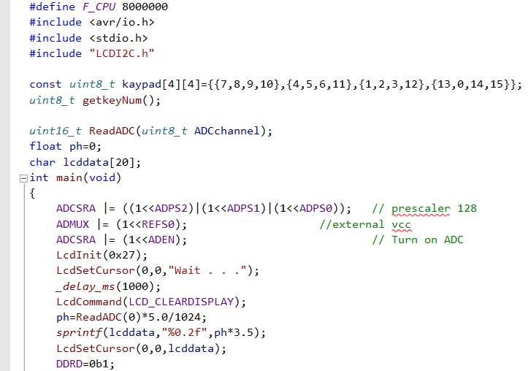
CODE

Slide 38
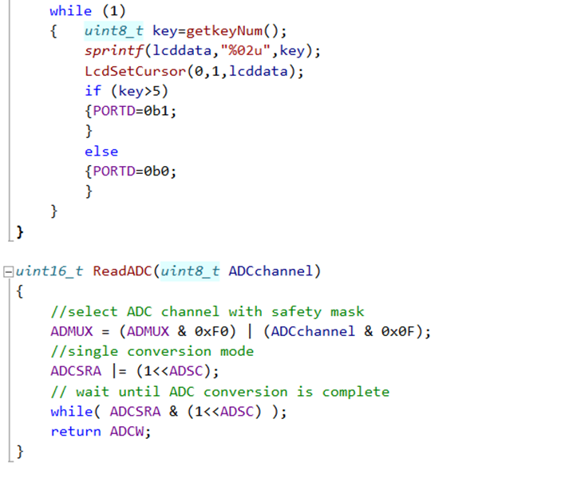
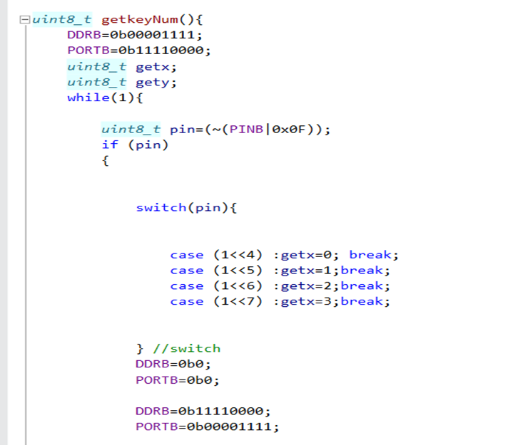

Slide 39
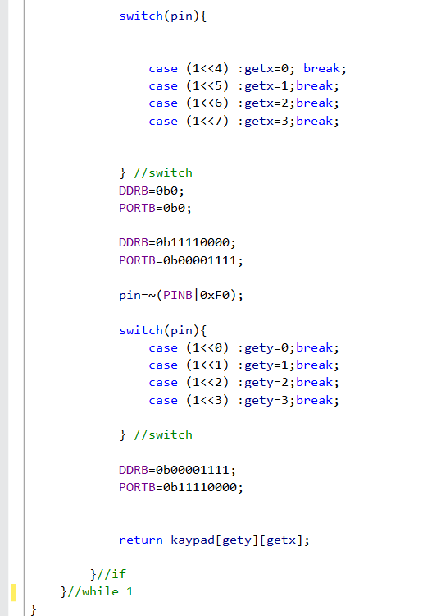

Slide 40
Member 03: Appuhamy H.D.S.A.N- 204006J
Manufacturing a shrimp farming system is our hardware project. By interacting with my project partners, attending hardware project meetings, and completing research, I was able to identify what needed to be done. We begin by drafting the proposal by describing our problem and the proposed remedy. I learnt about the technology we intend to employ to construct the system during the course of those days.
● Work on real time clock module(RTC), LCD(I2C) & GSM Module
● Simulate the project using Proteus
● Design a 3D animation using blender
I have learnt about designing and coding an alarm system used with RTC module. I mention that I have learnt to use Proteus to design the circuits and I used blender to create a animation. In this time I have completed my work on this project.

Slide 41
Responsibilities
Do a research about my components and identify what are the components that can be use in our project.
Identifying the correct pins and connect my components into the microcontroller accuracy.
Integrate GSM Module, RTC and LCD Display with the complete project
Attend to every group meeting and activities and collaborate with my colleges.
Make a 3D animation of our project in blender and ensure that it show that how my components are working in our project.

Slide 42
Techniques
RTC
First time when our system launch, it need to add the current time.
When the system is running RTC must return the current time.
RTC will be use for identify the feeding the shrimps or turn on/off lights time.
LCD
Show the current time, temperature, pH value, mass of food.
Show the keyboard inputs.
Show the data input settings in the startup
GSM
Send messages to the mobile-phone.

Slide 43
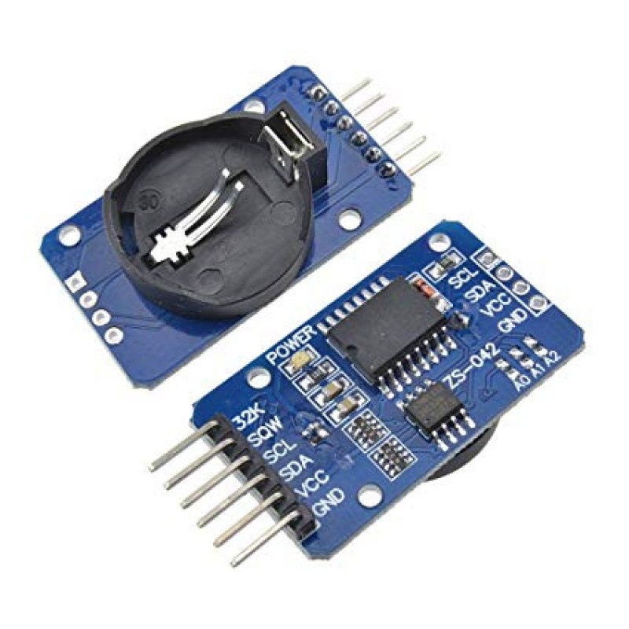
RTC (Real Time Clock Module)
Specification (ds3232):
Low power full BCD clock/calendar
2 main power sources can be connected.
Maximum voltage of primary supply is 5.5v.
Minimum voltage of primary supply is 2.3v.
Maximum voltage of secondary supply is 5.5v.
Minimum voltage of secondary supply is 2.3v.
Maximum current is 200 µA and 350 µA .
Connecting via I2c protocol.
Link to datasheet DS3232 Datasheet

Slide 44
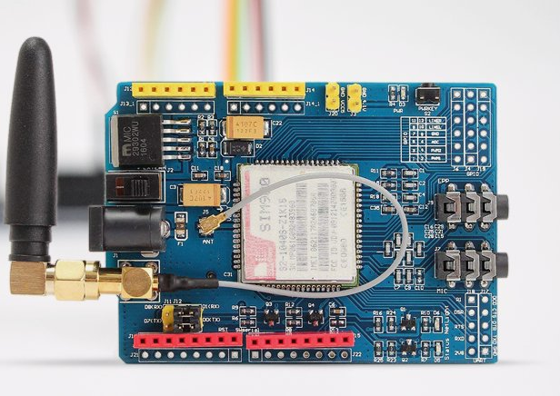
GSM Module
Specification (SIM900D):
Power supply range between 3.4V – 4.5V
It is quad-band GSM module, and it has 4 frequencies such as GSM 850, EGSM 900, DCS 1800, and PCS 1900.
Normally it can operate in -30°C to +80°C temperature.
Maximum downlink speed is 85.6 kbps and maximum uplink speed is 42.8 kbps.
Support SIM card: 1.8V, 3V.
Link to datasheet SIM900D Datasheet

Slide 45
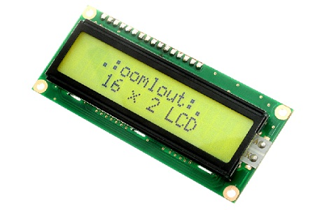
16x2 LCD Display
Specification (LM016L):
Power supply range between 1.5V – 5.5V
Character size 5x7 Dots
Dot size 0.56 X 0.66 mm
Module Size 84 X 44 X 10.5 mm
Connecting via I2c protocol.
Link to Datasheet LM016L Datasheet

Slide 46
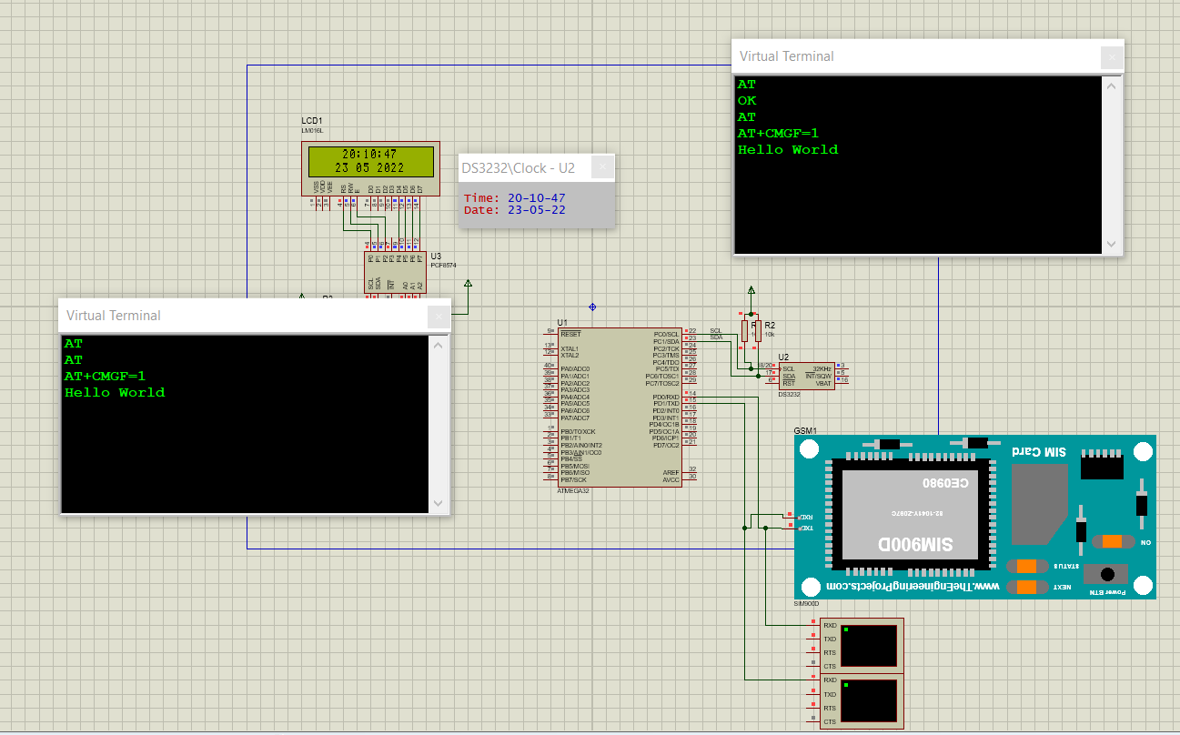
Circuit Diagram

Slide 47
Code
int main(void){
_delay_ms(500);
LcdInit(0x27);
USART_Init(9600);
_delay_ms(500);
USART_TxStringln("AT");
_delay_ms(500);
USART_TxStringln("AT");
_delay_ms(500);
USART_TxStringln("AT+CMGF=1");
_delay_ms(500);
USART_TxStringln("Hello World");
setTime(22,9,33,23,12,21); //hour , minute, second, date, month, year
while (1)
{Readtime();
sprintf(lcddata,"%02u:%02u:%02u",hourC,minC,secC);
LcdSetCursor(4,0,lcddata);
sprintf(lcddata,"%02u %02u 20%02u",dateC,monthC,YearC);
LcdSetCursor(3,1,lcddata);
}
}
#define F_CPU 8000000
#include <avr/io.h>
#include <util/delay.h>
#include <stdio.h>
#include "headers/LCDI2C.h"
#include "headers/USART.h"
void setTime(uint8_t hSet,uint8_t mSet,uint8_t sSet /*,uint8_t dSet*/ ,uint8_t dateSet,uint8_t monthSet, uint8_t yearSet);
void Readtime();
uint8_t dayC;
uint8_t hourC;
uint8_t minC;
uint8_t secC;
uint8_t dateC;
uint8_t monthC;
uint8_t YearC;
char lcddata[20];

Slide 48
Code Cont. (SetTime Function)
void setTime(uint8_t hSet,uint8_t mSet,uint8_t sSet /*,uint8_t dSet*/ ,uint8_t dateSet,uint8_t monthSet, uint8_t yearSet){
TWIStart();
TWIWriteAddrs(104,0);
TWIWriteData(0x02);
TWIWriteData(((hSet/10)<<4)|(hSet%10));
TWIStop();
TWIStart();
TWIWriteAddrs(104,0);
TWIWriteData(0x01);
TWIWriteData(((mSet/10)<<4)|(mSet%10));
TWIStop();
TWIStart();
TWIWriteAddrs(104,0);
TWIWriteData(0x00);
TWIWriteData(((sSet/10)<<4)|(sSet%10));
TWIStop();
TWIStart();
TWIWriteAddrs(104,0);
TWIWriteData(0x04);
TWIWriteData(((dateSet/10)<<4)|(dateSet%10));
TWIStop();
TWIStart();
TWIWriteAddrs(104,0);
TWIWriteData(0x05);
TWIWriteData(((monthSet/10)<<4)|(monthSet%10));
TWIStop();
TWIStart();
TWIWriteAddrs(104,0);
TWIWriteData(0x06);
TWIWriteData(((yearSet/10)<<4)|(yearSet%10));
TWIStop();
}

Slide 49
Code Cont. (ReadTime Function)
uint8_t bit[7];
TWIStart();/* Start I2C with device write address */
TWIWriteAddrs(104,0); //Return 24 mean device found, return mean no device
TWIWriteData(0); //Register address
TWIStart();
TWIWriteAddrs(104,1); //Write bit
bit[0]=TWIReadACK();
bit[1]=TWIReadACK();
bit[2]=TWIReadACK();
bit[3]=TWIReadACK();
bit[4]=TWIReadACK();
bit[5]=TWIReadACK();
bit[6]=TWIReadNACK();
//h|=TWIReadACK()<<8;
//h|=TWIReadNACK()<<16;
TWIStop();
secC=(((bit[0]&0xF0)>>4)*10)+(bit[0]&0xF);
minC=(((bit[1]&0xF0)>>4)*10)+(bit[1]&0xF);
hourC=(((bit[2]&0b00110000)>>4)*10)+(bit[2]&0xF);
dayC=bit[3]&0b111;
dateC=(((bit[4]&0xF0)>>4)*10)+(bit[4]&0xF);
monthC=(((bit[5]&0xF0)>>4)*10)+(bit[5]&0xF);
YearC=(((bit[6]&0xF0)>>4)*10)+(bit[6]&0xF);

Slide 50
Member 04: Rajapaksha S.S.D- 204171H
Our hardware project will be to build a shrimp food mechanism. I had no idea what I had to accomplish at first. However, after interacting with my project teammates and engaging in hardware project meetings, as well as reading research, I realized what needed to be done. First, we draft the proposal by stating our problem and the recommended remedy. I learnt about the technology that we aim to employ to build the system throughout those days.
I've learnt a lot of new things. Not only the study-related things, but also how to operate in a team and interact with team members

Slide 51
Responsibilities
What is a gear motor and how does it work?
How to Hook Up a Gear Motor to an Atmega32 Microcontroller
What is a weight sensor and how does it work?
How to Hook Up a Weight Sensor to an Atmega32 Microcontroller
The buzzer and how it works
How to Hook Up a Buzzer to an Atmega32 Microcontroller
Refer to the code section of them
Identifying devices required for attaching sensors to an atmega32 microcontroller
Learning to create 3D animations

Slide 52
Techniques
Weight Sensor : Measure weight of the food tank
Gear Motor: It helps to distribute the food 360 degrees and throw away
Buzzer: When a message is sent, the buzzer will sound

Slide 53
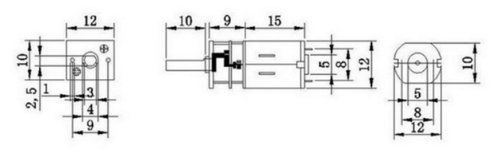
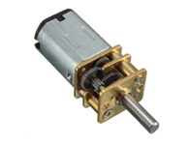
Gear Motor
Specifications:
Rated Voltage : 12V Model:GA12-N20
Revolving Speed : 200 RPM
Load Speed : 80 RPM
Rated Torque : 2 kgcm
Stall Torque : 16 kgcm
Rated Current : 70 mA
Stall Current : 1 A
Gear Material : Full Metal
Link to Data sheet:
https://www.handsontec.com/dataspecs/GA12-N20.pdf

Slide 54
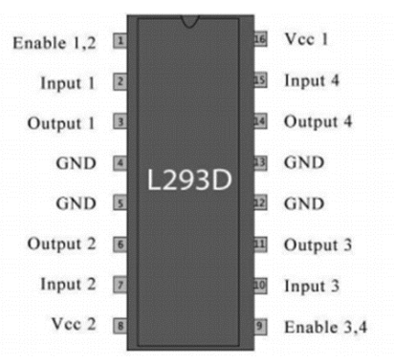
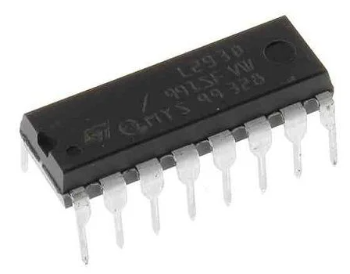
L293D Motor Driver
Specifications:
Type: Half Bridge
Operating Supply Voltage: 4.5 V to 36 V
Output Current :600 mA
Operating Supply Current: 2 mA
Minimum Operating Temperature: - 40 C
Maximum Operating Temperature: + 150 C
Unit Weight: 270 mg
Number of Outputs: 2 Output
Link to the Data sheet:
https://cdn-shop.adafruit.com/datasheets/l293d.pdf

Slide 55
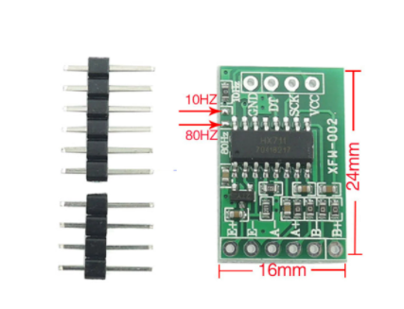
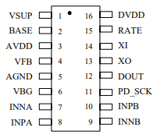
Weight Sensor / HX711 Module
Specifications :
Maximum current: <1.5 mA
Operation supply Voltage range: 2.7 ~ 5.5V
Operation temperature Range: -40~+85
Weight: 5g
Link to refer Speciation Data Sheet:
https://cdn.sparkfun.com/datasheets/Sensors/ForceFlex/hx711_english.pdf

Slide 56
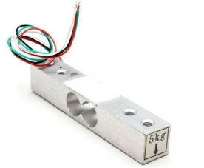
Load Cell /YZC-131A
Specifications :
Insulation Resistance: 2000MΩ
Excitation Voltage: 5V
Recommended Operating Voltage: 5V
Maximum Operating Voltage: 10V
Material: Aluminum
Rated Load: 1Kg, 2Kg, 3Kg, 5Kg
Input Impedance: 1000 ohm
Output Impedance: 1000 ohm
Link to refer Speciation Data Sheet:
https://www.electronicoscaldas.com/datasheet/YZC-131A.pdf

Slide 57
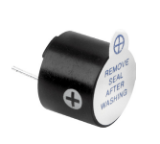
Buzzer
Specifications:
Rated Voltage : 6V DC
Operating Voltage : 4 to 8V DC
Rated Current* : ≤30mA
Sound Output at 10cm* : ≥85dB
Resonant Frequency : 2300 ±300Hz
Tone : Continuous
Operating Temperature : -25°C to +80°C
Storage Temperature : -30°C to +85°C
Weight : 2g
Link to refer Speciation Data Sheet: Buzzer Datasheet

Slide 58
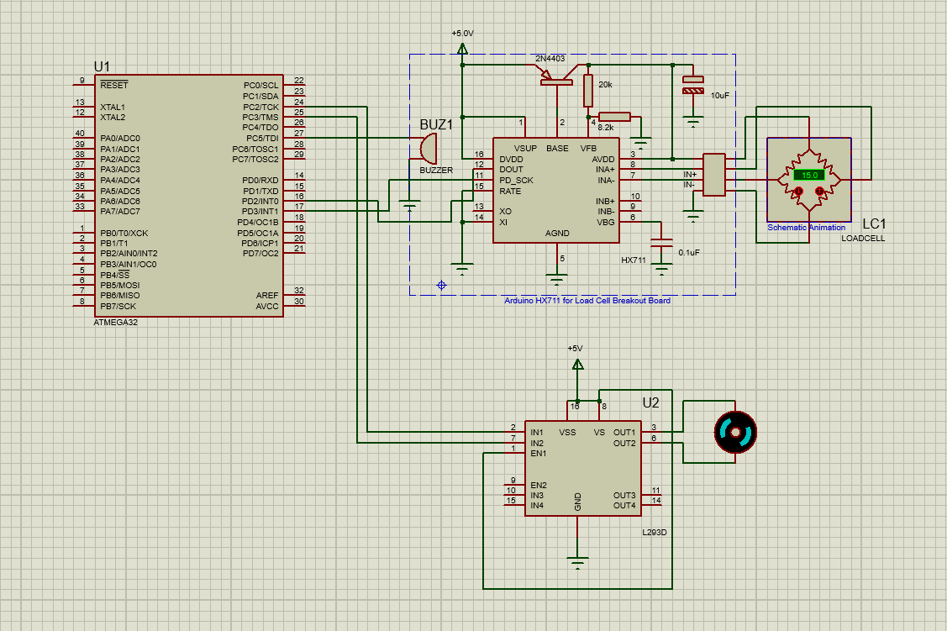
Circuit Diagram

Slide 59
Code I
#define F_CPU 8000000 //Internal oscillator speed
#include <avr/io.h>
#include <util/delay.h> //Delay library
uint8_t hx711H=0; //Load Scale High Bits
uint16_t hx711L=0; //Load Scale Low Bits
float loadCellRead(); //define function
#define Load_data 2
#define Load_clk 3
#define MotorCCW 2
#define MotorCw 3
float loadCellRead();
void MotorControl(uint8_t dir);
float hx=0;
int main(void)
{
DDRD|=(1<<Load_clk); //Load cell clock pin
PORTD&=~(1<<Load_clk); //Clock pin low
DDRC|=(1<<5)|(1<<MotorCw)|(1<<MotorCCW); //buzzer & motor
while (1)
{
hx=loadCellRead();
if (hx>15)
{PORTC|=(1<<5);MotorControl(1); //Port C 5 pin ON (buzzer) //And give to MotorControl function = 1
}
else
{PORTC&=~(1<<5);MotorControl(0); //Port C 5 pin OFF (buzzer) //And give to MotorControl function = 0
}
_delay_ms(100);
}
}

Slide 60
Code II
void MotorControl(uint8_t dir){ //pass MotorControl value to dir
if (dir) //If MotorControl = 1,Do this
{PORTC|=(1<<MotorCCW); //portC 2 on
PORTC&=~(1<<MotorCw); //portC 3 off
}
else
{PORTC|=(1<<MotorCw); //portC 3 on
PORTC&=~(1<<MotorCCW); //portC 2 off
}
}
float loadCellRead(){
hx711H=0;hx711L=0; //clear variables
for(uint8_t i=0;i<8;i++){ // Load cell data high 8 bits
PORTD|=(1<<Load_clk); //Clock pin high
_delay_us(10);
if ((PIND&(1<<Load_data))>>Load_data) //read data pin //Read PortD 2 pin
{hx711H|=(1<<(7-i));//set hx 711 variable //hx711H variable bit high
}
else
{hx711H&=~(1<<(7-i)); //hx711H variable bit low
}
PORTD&=~(1<<Load_clk); //Clock pin low
_delay_us(5);
}

Slide 61
Code III
for(uint8_t i=0;i<16;i++){ // Load cell data low 16 bits
PORTD|=(1<<Load_clk); //Clock pin high
_delay_us(10);
if ((PIND&(1<<Load_data))>>Load_data) //read data pin
{hx711L|=(1<<(15-i));
}
else
{hx711L&=~(1<<(15-i));
}
PORTD&=~(1<<Load_clk); //Clock pin low
_delay_us(5);
}
hx711L=hx711L>>1; //shift bits
if (hx711H&1) //bit setup
{hx711L|=(1<<15);
}
else
{hx711L&=~(1<<15);
}
hx711H=hx711H>>1;
return (hx711H*(65536/18029.6))+hx711L/18029.6; //load cell calibration
}

Slide 62
Member 05: Perera J.K.A.T- 204155M
Learned about EEPROM OF ATMEGA32
Learned to simulate using Proteus
Learned to do 3D animation
Learned about EEPROM
Learned about power supply
Our hardware project will be to manufacture a shrimp feeding mechanism. I recognized what needed to be done by engaging with my project teammates, attending hardware project meetings, and conducting research. First, we draft the proposal by stating our problem and the recommended remedy. Then we did interim evaluation and now we do final evaluation I gathered theoretical knowledge on my components of this project.

Slide 63
Responsibilities
Learning EEPROM of Atmega 32 and how it works About Temperature sensor and how it works How to connect to Temperature sensor to atmega32 microcontroller Refer the code part of them
Learning about power supply
How connect to power supply to circuit Identifying devices needed to when connecting to those sensors to atmega32 microcontroller Learning to do 3D animations

Slide 64
Techniques
EEPROM of Atmega 32
This use for store the temperature value which read by the
temperature sensor.
This store the values as hexadecimal format
Temperature sensor
This component measures the temperature of water in the pond.
Then it send to eeprom of atmega 32 for store the value

Slide 65
Techniques
Power Supply
This provides the electricity for the circuit.
This can supply 5v voltage for the circuit
This can generate a ac current is's voltage is 230v and using transformer it reduced to 21 voltage
Then it go the 7805 regulator and provide 5 volatage for the circuit.

Slide 66
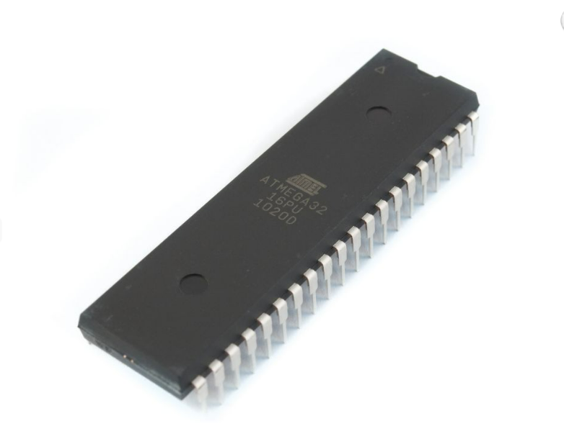
EEPROM of ATMEGA 32
Specifications :​
EEPROM is Electrically Erasable Programmable Read-Only Memory. This is 1024 bytes memory t is non-volatile type of memory as it holds the data even when power is off. it can store data as hexadecimal values It can read modify/write this memory in runtime application.
Link to refer Speciation Data Sheet:
https://www.mouser.com/datasheet/2/268/2503s-1065182.pdf

Slide 67
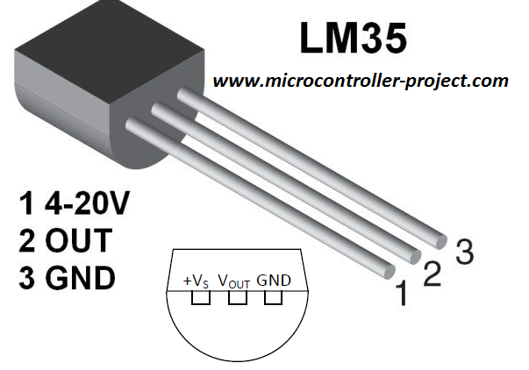
Temperature Sensor(LM35)
Specifications
Calibrated Directly in Celsius (Centigrade) Linear + 10-mV/°C Scale Factor 0.5°C Ensured Accuracy (at 25°C) Rated for Full −55°C to 150°C Range Suitable for Remote Applications Operates from 4 V to 30 V Less than 60µA Current Drain Low Self-Heating, 0.08°C in Still Air Non-Linearity Only ±¼°C Typical
Low-Impedance Output, 0.1 Ω for 1-mA Load
Datasheet: https://www.electroschematics.com/wp-content/uploads/2010/02/LM35-DATASHEET.pdf

Slide 68
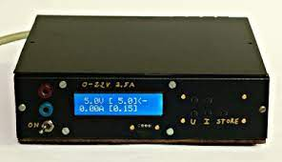
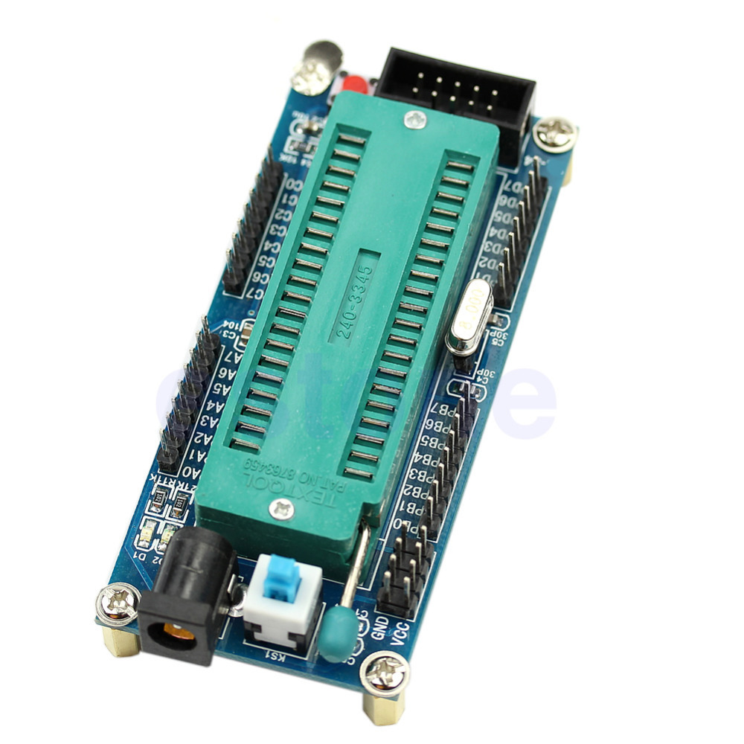
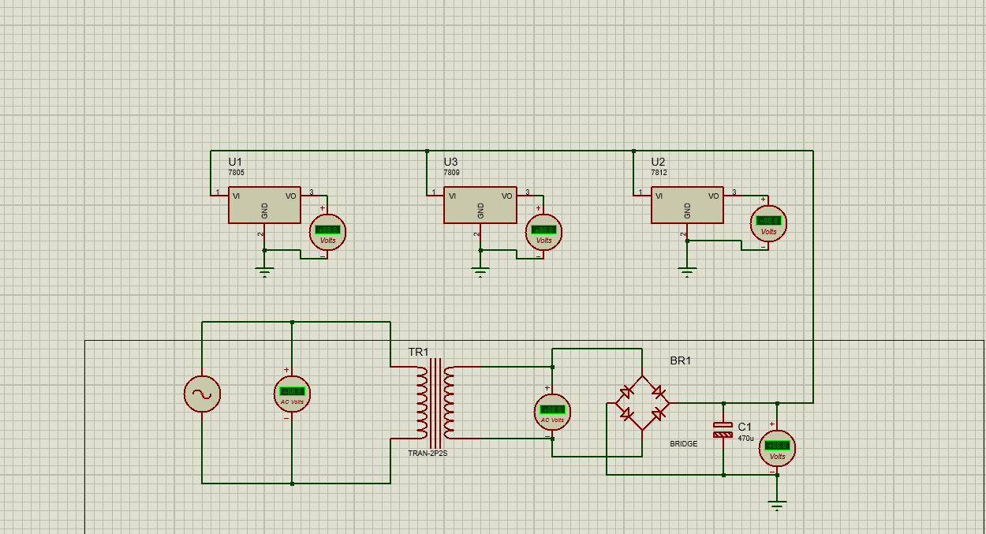
Power Supply
Specifications:
Input voltage is 230v.
AC current generated.
Transformer reduce the voltage.
Has a 7805 regulator.

Slide 69
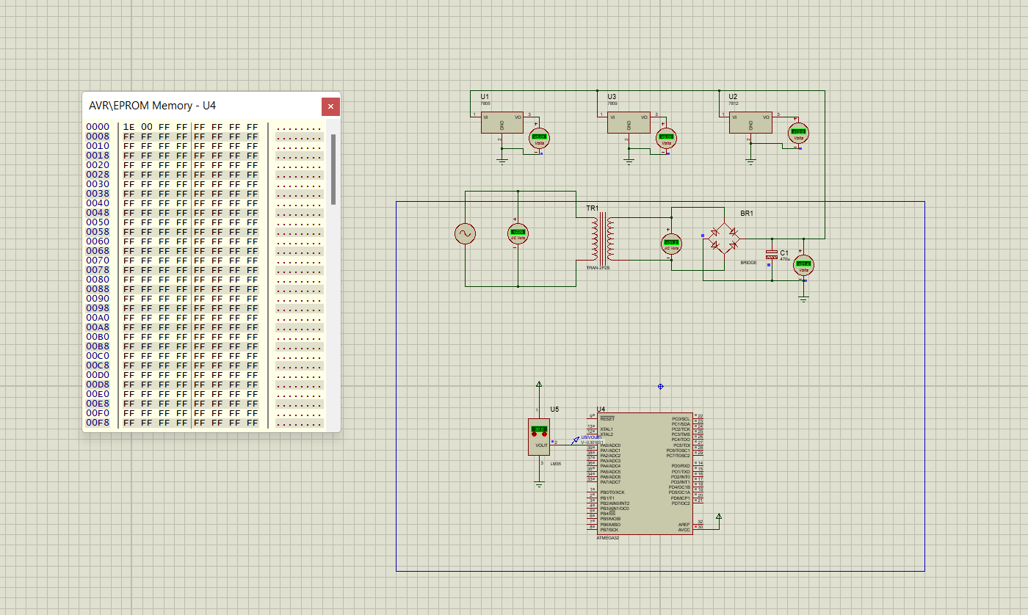
Circuit Diagram

Slide 70

code

Slide 71

Code 2

Slide 72
Thank You
Questions

